Slide 1

Comfy Week !
Présente

Slide 2

“A comfortable week with ComfyUI.”
“Une semaine confortable avec ComfyUI.”

Slide 3



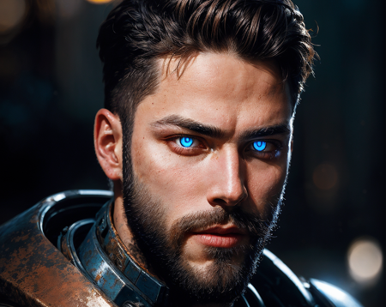

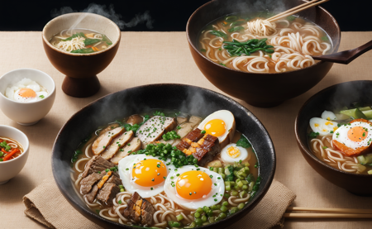

Slide 4







Slide 5
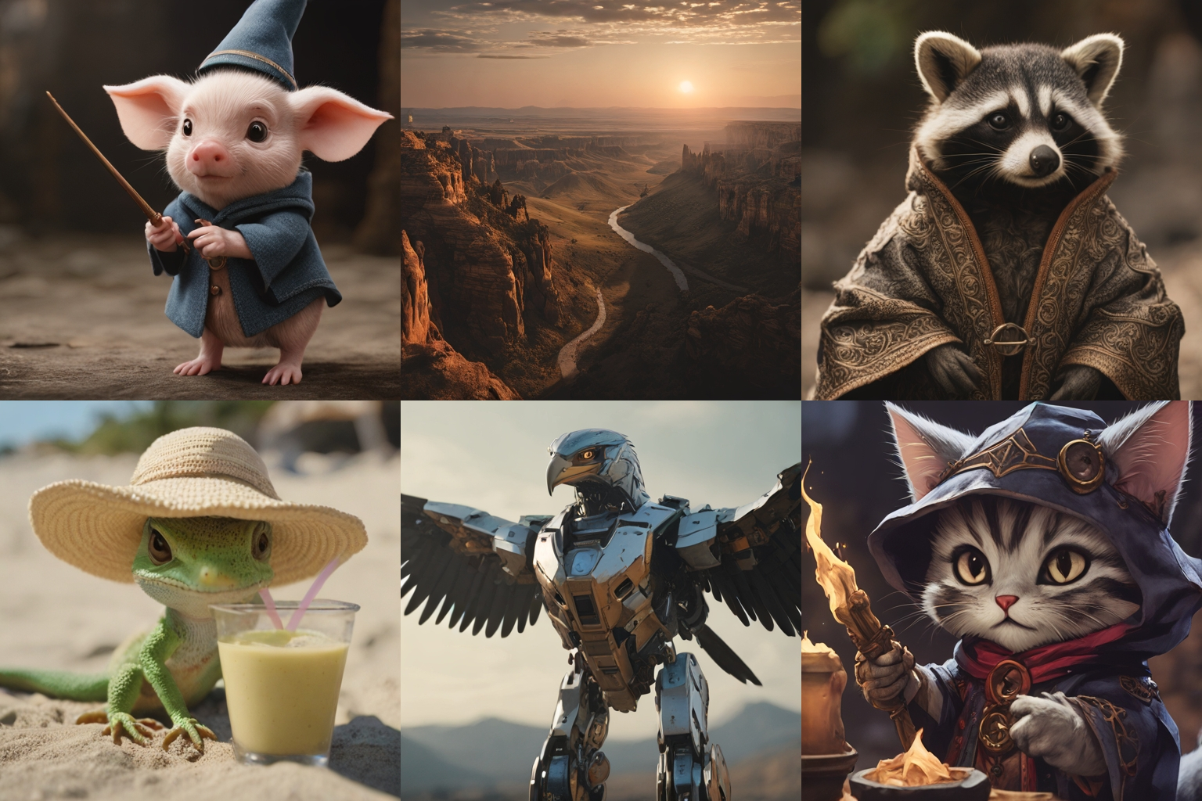
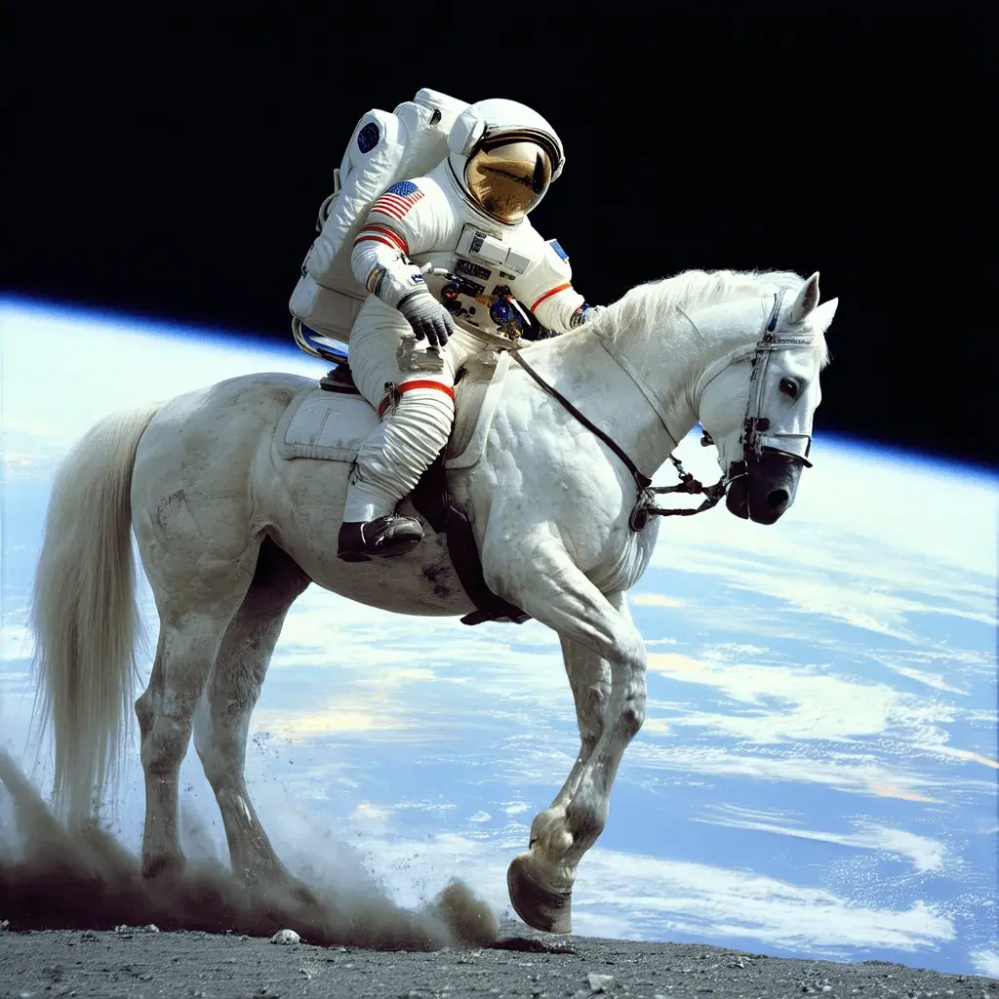



What is stable diffusion?
Stable Diffusion is a text-to-image deep learning model
Code and model weights have been released publicly
Can run on a GPU with 4 GB VRAM (<500$ hardware)
An astronaut
riding a horse

Slide 6

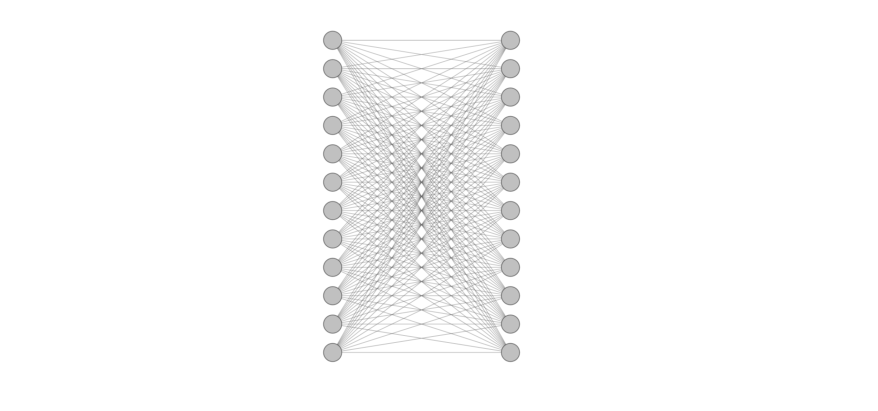
What is a machine learning / artificial intelligence model?
Small network
Big network
+ Low compute cost
- Low “intelligence”
+ High “intelligence”
- High compute cost

Slide 7


Random images vs Meaningful images

Slide 8
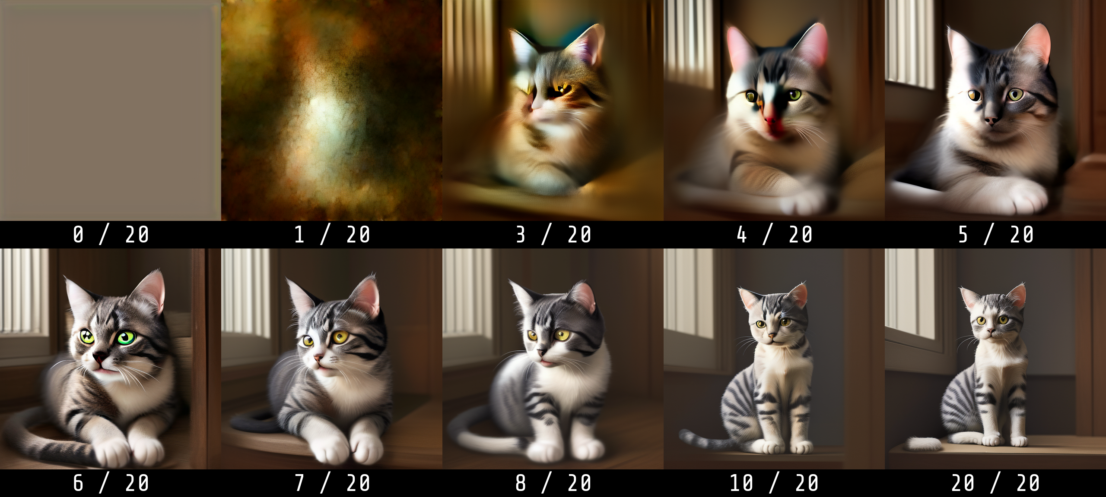
Generation steps

